Slide 1

Future Cart: AI-Driven Demand Prediction for Smarter Retail
-Enhancing E-Commerce through Effective Demand Forecasting
Presented By:
Uday Sankar De

Slide 2
Contents
Problem Statement
Dataset Overview
Python libraries used
Exploratory Data Analysis
Feature Engineering
Visualisation
Time Series Analysis
Demand Forecasting Models
Comparison Of All Forecasting Models
Prediction with best model value
Conclusion

Slide 3
Problem Statement
This project aims to develop a sophisticated model using historical sales data and Google Analytics KPIs, like Google clicks and Facebook impressions.
To predict future product demand and understand customer behavior.
Outcomes:
Develop Demand Forecasting Model
Identify Trends and Seasonal Patterns
Build Predictive Models

Slide 4
Dataset Overview
ProductA.csv:
Contains data related to product demand, including day index and quantity sold.
Used for analyzing trends and forecasting demand.
ProductA_google_clicks.csv:
Includes daily data on Google clicks.
Helps in understanding the correlation between Online advertising and product demand.
ProductA_fb_impressions.csv:
Captures daily Facebook impressions.
Useful for examining the impact of social media advertising on product demand.

Slide 5
Python Libraries Used
Pandas
Numpy
Matplotlib
Saborn
Statsmodels
Scikit-learn
Warnings
Regression

Slide 6
Exploratory Data Analysis
Merging the data :
Initially the data contains Product A : (212, 4) Product A Google Clicks : (212, 4) Product A Facebook Impressions : (212, 4)
Merged the three datasets with Day Index column . Merged data : (212, 4)
Here for no data loss , we used full join.

Slide 7
Massing Values Imputation : There are no missing values.
Outliner detection and replacement :
Identify Outliers:
Calculate Q1 (25th percentile) and Q3 (75th percentile)
Compute IQR (Interquartile Range):
IQR=Q3−Q1
Define bounds: Lower=Q1−1.5×IQR, Upper=Q3+1.5×IQR
Quantity column contains outliers.
Replaced the outliers with median value of the Quantity column.

Slide 8
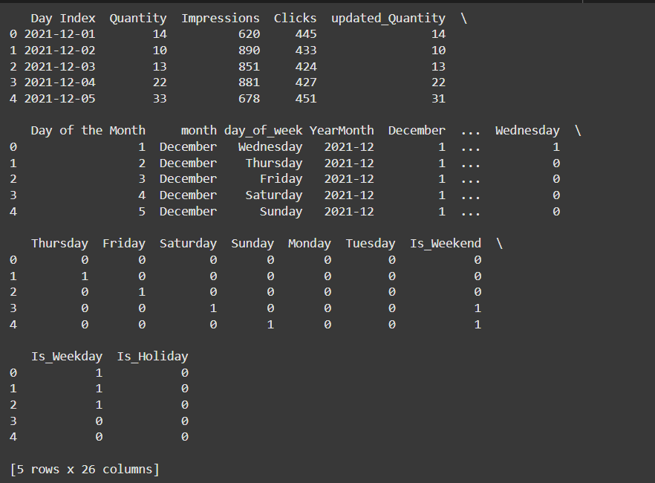
Feature Engineering
Date-related Features
Month-specific Features
Day-specific Features
Quantity, Impressions, Clicks
Clicks per impressions
Quantity squared

Slide 9
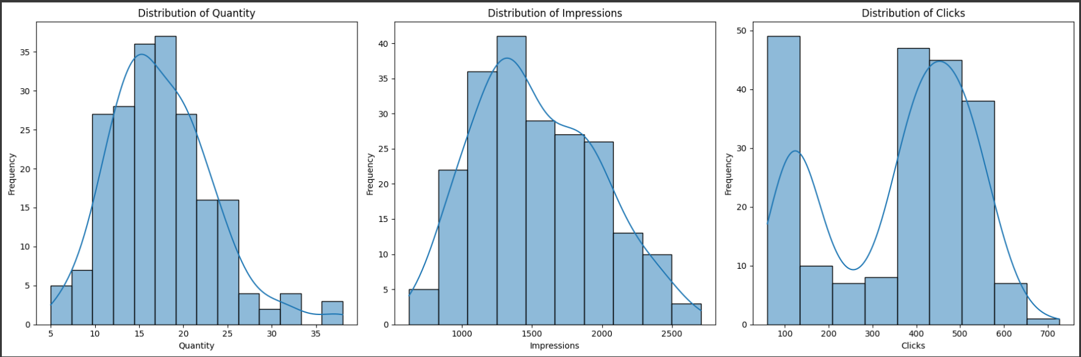
Histogram of numerical columns:
Quantity: There are a few values above 30, which appear to be outliers compared to the bulk of the data centered around 10-20.
Impressions: There are a few data points above 2500, indicating possible outliers.
Clicks: Values above 600 appear as outliers, as most of the data is centered around 200-500.

Slide 10
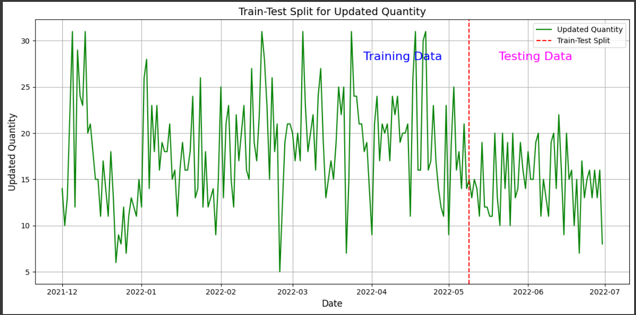
Time Series Analysis
Train-Test Spit for modelling : I dived the dataset into 75:25 for train and test.

Slide 11
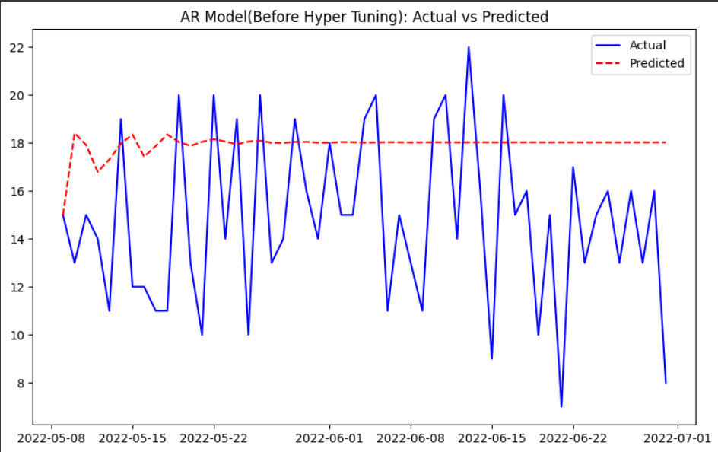
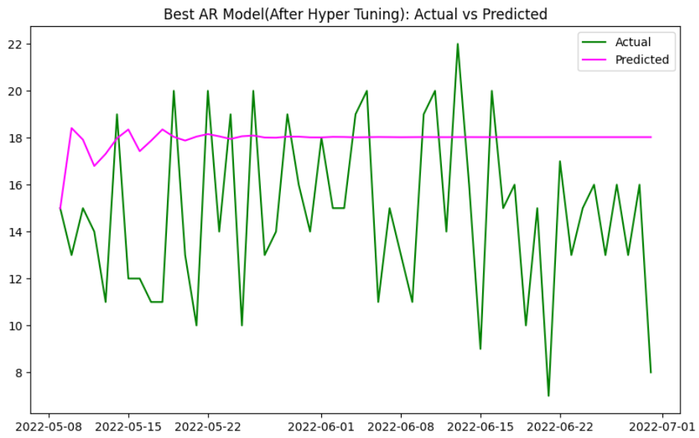
Demand Forecasting Models
AR Model :
Model matrices:
AR Model Metrics(Before Hyper Tuning):
MAE: 3.9590924927959743
RMSE: 4.743013014627009
MAPE: 33.40%
R^2: -0.8348359010305346
Differencing Mean: 0.0
AR Model Metrics(After Hyper Tuning):
MAE: 3.9590924927959743
RMSE: 4.743013014627009
MAPE: 33.40%
R^2: -0.8348359010305346

Slide 12
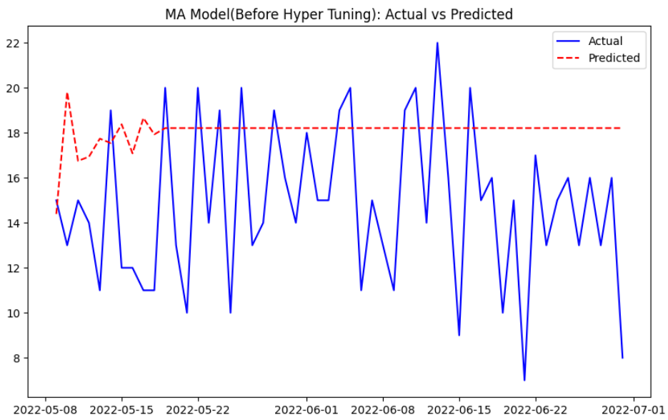
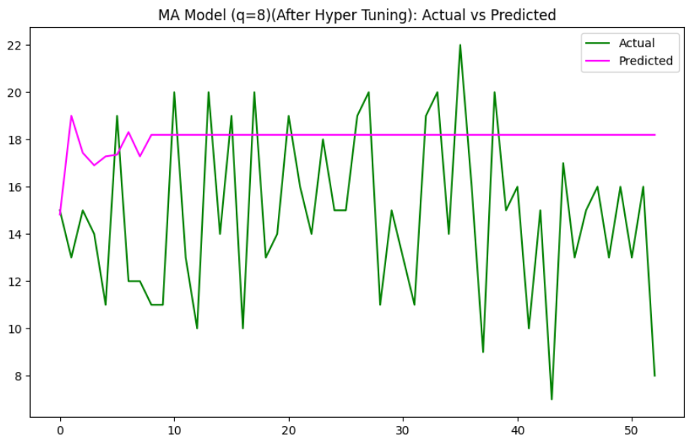
MA Model :
Model matrices:
MA Model Metrics(Before Hyper Tuning):
MAE: 4.071225093420155
RMSE: 4.881079364654831
MAPE: 34.37%
R^2: -0.9432126759942605
Differencing Mean: 0.0
Best MA Model Metrics(After Hyper Tuning):
q: 8
MAE: 4.0480
RMSE: 4.8437
MAPE: 34.15%
R^2: -0.9135

Slide 13
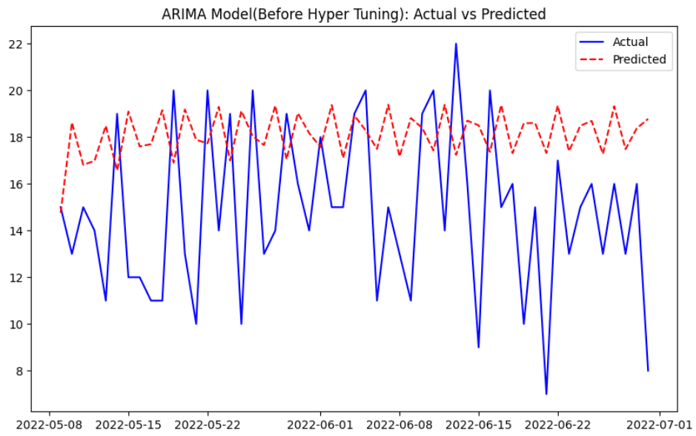
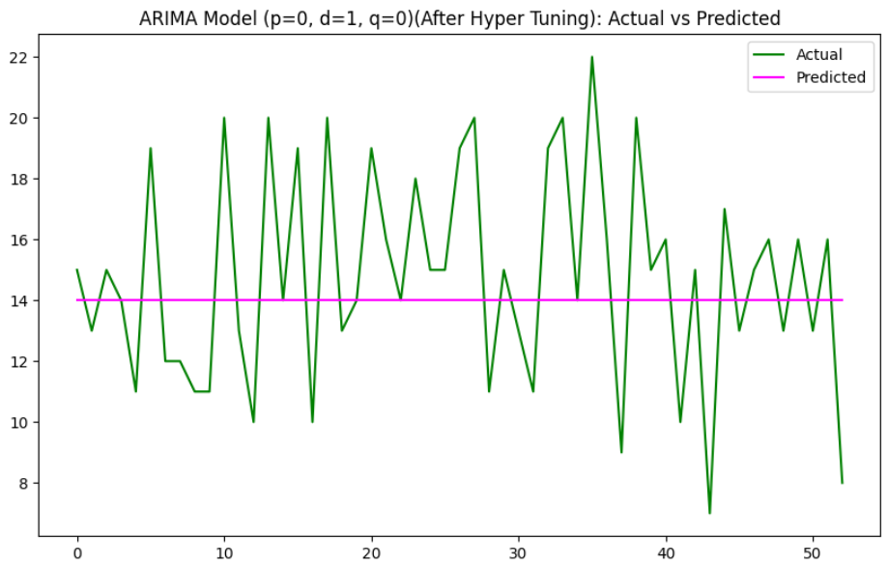
ARIMA Model:
Model matrices:
ARIMA Model Metrics(Before Hyper Tuning):
MAE: 4.362147563340008
RMSE: 5.090531375937143
MAPE: 36.11%
R^2: -1.1135612287318817
Differencing Mean: 0.0
Best ARIMA Model Metrics(After Hyper Tuning):
(p, d, q): (0, 1, 0)
MAE: 2.8679
RMSE: 3.5819
MAPE: 20.57%
R^2: -0.0465

Slide 14
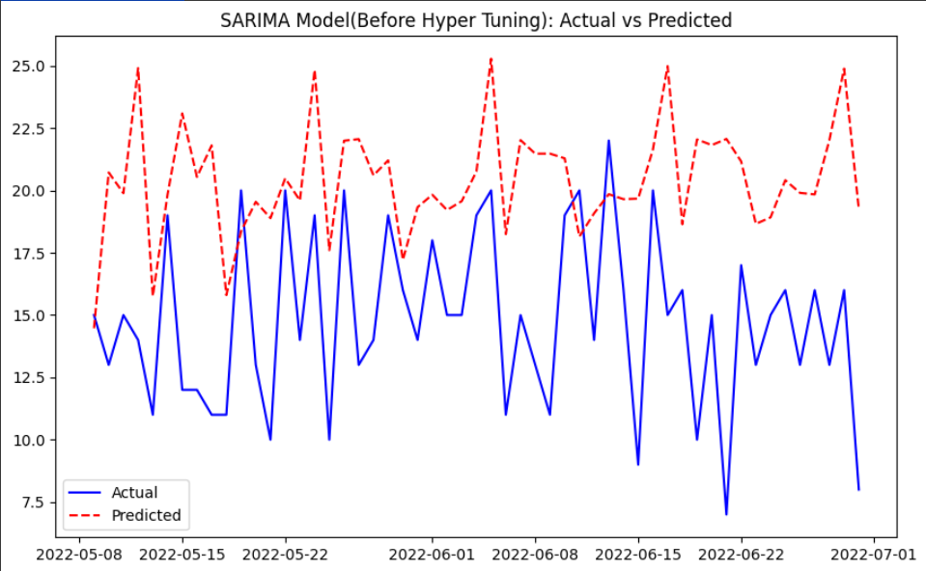
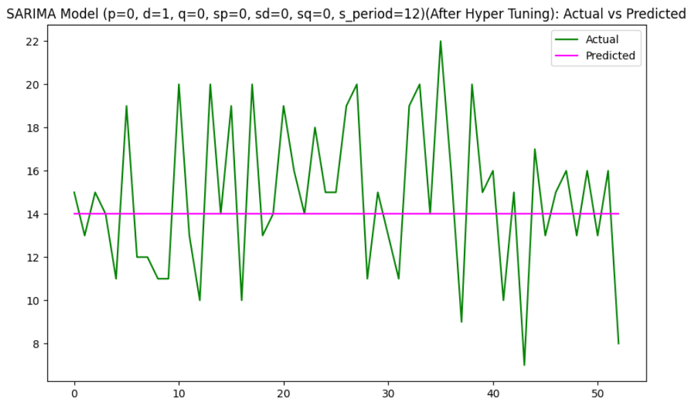
SARIMA Model:
Model matrices:
SARIMA Model Metrics(Before Hyper Tuning):
MAE: 5.860311727774639
RMSE: 6.808527425308862
MAPE: 47.73%
R^2: -2.780898152573253
Differencing Mean: 0.0
Best SARIMA Model Metrics (After Hyper Tuning):
(p, d, q, sp, sd, sq, s_period ) :(0, 1, 0, 0, 0, 0, 12)
MAE: 2.8679
RMSE: 3.5819
MAPE: 20.57%
R²: -0.0465

Slide 15
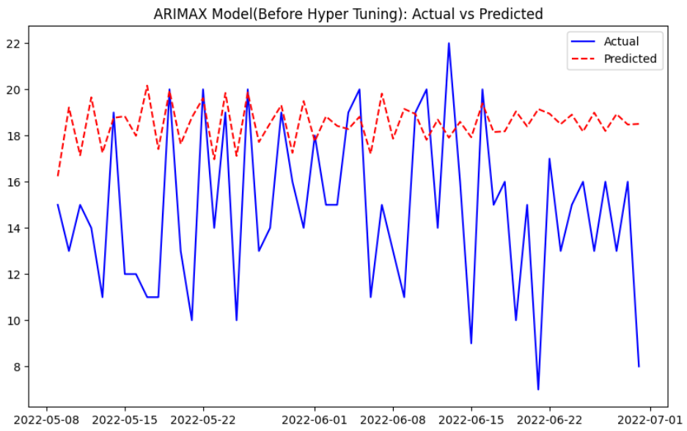
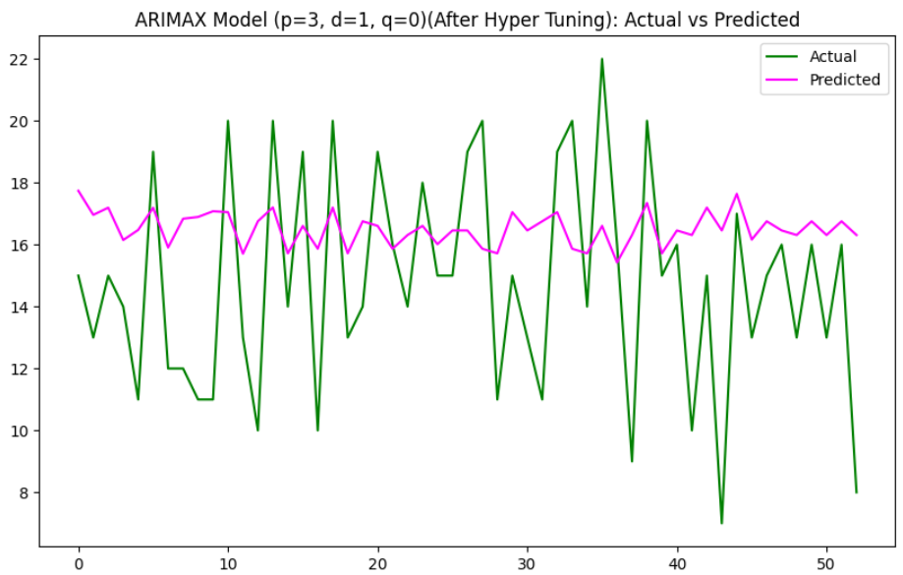
ARIMAX Model:
Model matrices:
ARIMAX Model Metrics(Before Hyper Tuning):
MAE: 4.123457399182951
RMSE: 5.084099610018834
MAPE: 35.21%
R^2: -1.1082237335790817
Differencing Mean: 0.0
Best ARIMAX Model Metrics(After Hyper Tuning):
(p, d, q): (3, 1, 0)
MAE: 3.1932
RMSE: 3.8304
MAPE: 26.27%
R^2: -0.1967

Slide 16
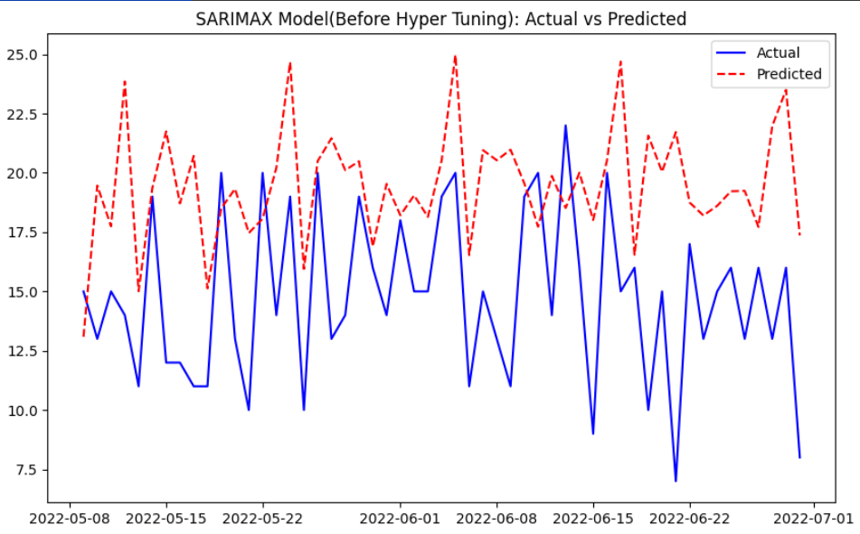
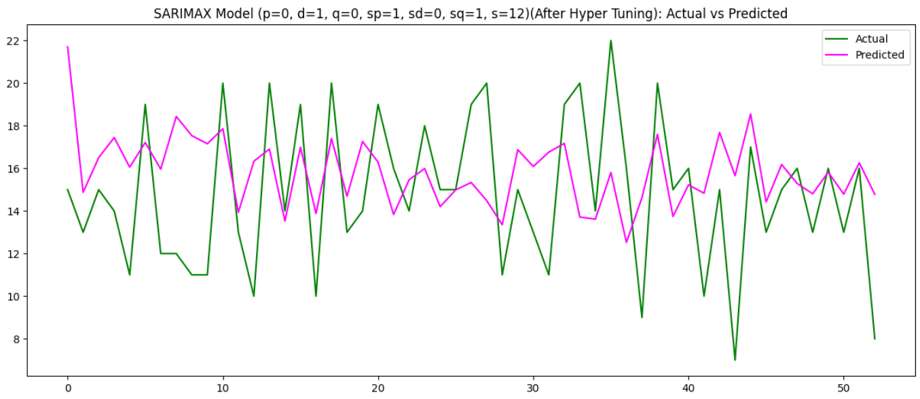
SARIMAX Model:
Model matrices:
SARIMAX Model Metrics(Before Hyper Tuning):
MAE: 5.1214
RMSE: 6.1175
MAPE: 41.98%
R^2: -2.0523
Differencing Mean: 0.0000
Best SARIMAX Model Metrics(After Hyper Tuning):
(p, d, q, sp, sd, sq, s): (0, 1, 0, 1, 0, 1, 12)
MAE: 3.0448
RMSE: 3.7255
MAPE: 24.16%
R^2: -0.1320

Slide 17
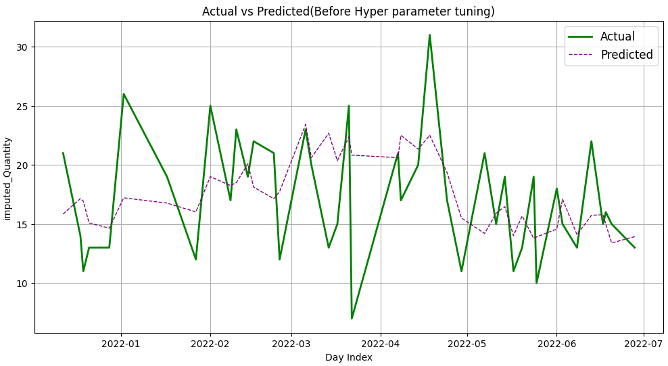
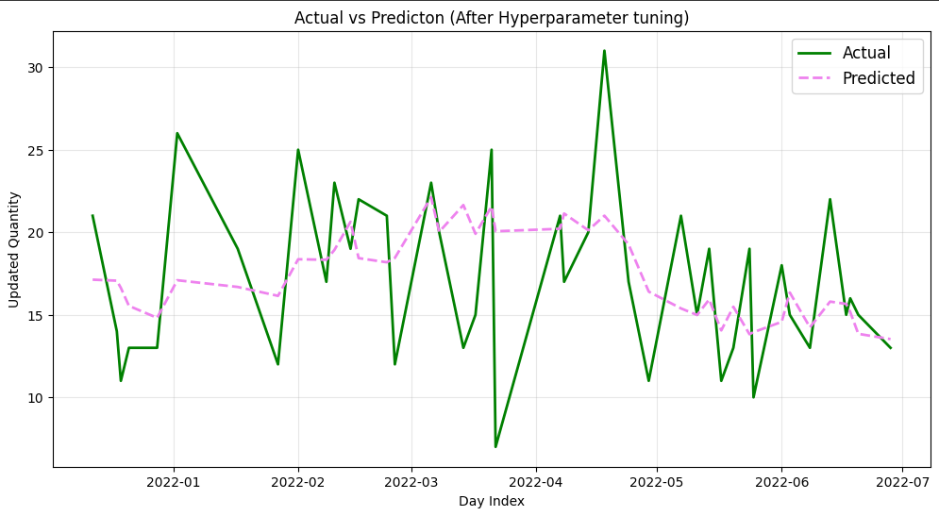
Multivariate Regression :
Model matrices:
Regression Model Metrics(Before Hyper Tuning):
Mean Absolute Error (MAE): 3.731685685392427
Root Mean Squared Error (RMSE): 4.690712376617928
Mean Absolute Percentage Error (MAPE): 25.27%
R-squared (R^2): 0.12577632482653622
Mean Difference: -0.2669851086558266
Regression Model Metrics(After Hyper Tuning):
Best Parameters: {'alpha': 100.0, 'solver': 'sparse_cg’}
Best Cross-Validation R2 Score: 0.06032603957264684
Mean Absolute Error (MAE): 3.6001516380970897
Root Mean Squared Error (RMSE): 4.587940447352256
Mean Absolute Percentage Error (MAPE): 24.30%
R-squared (R^2): 0.1636645612210903
Mean Difference: -0.1359280316784193

Slide 18
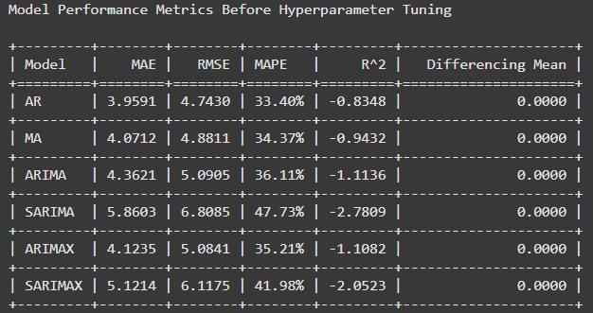
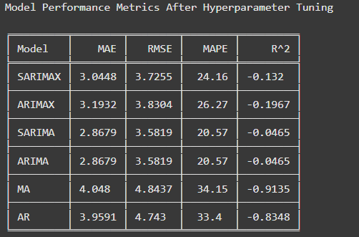
Comparison Of All Forecasting Models
All model matrices before & after hyperparameter tuning :
Although the SARIMA model has the lowest RMSE value (3.5819), it fails to capture the trends. In contrast, the SARIMAX model has a slightly higher RMSE value (3.7225) but successfully aligns with the trends. Therefore, I have chosen the SARIMAX model to predict the next two months.

Slide 19
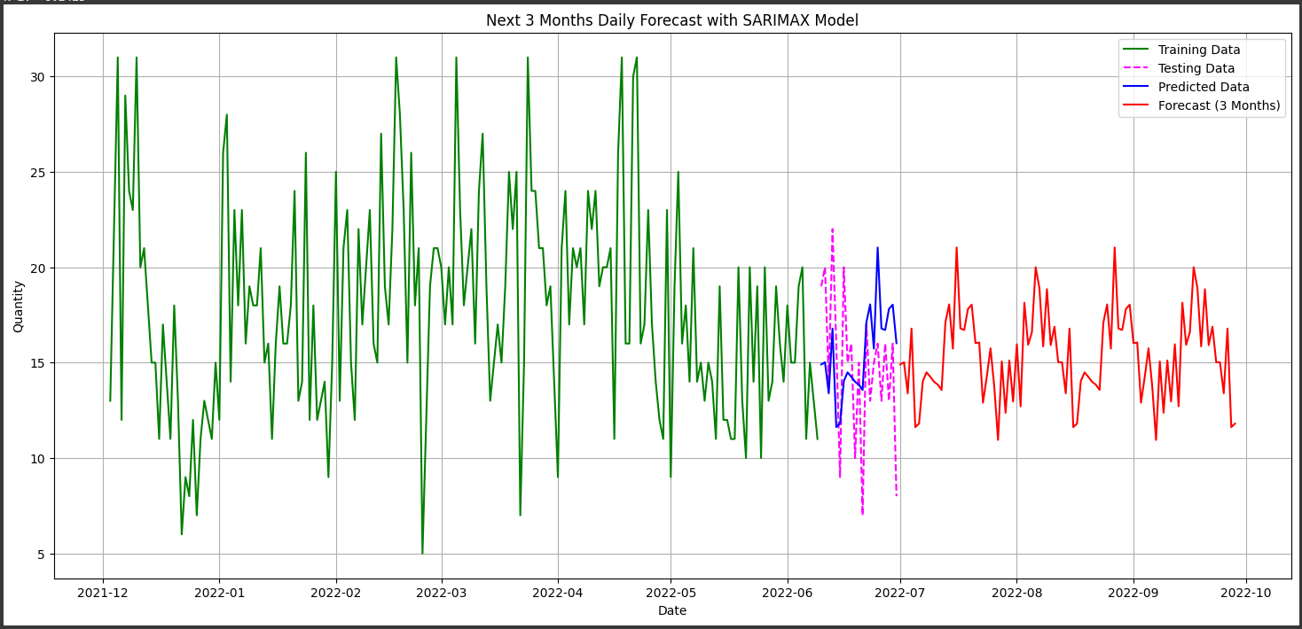
Prediction with best model value
By analysing all types of historical data this is the prediction for next three months.

Slide 20
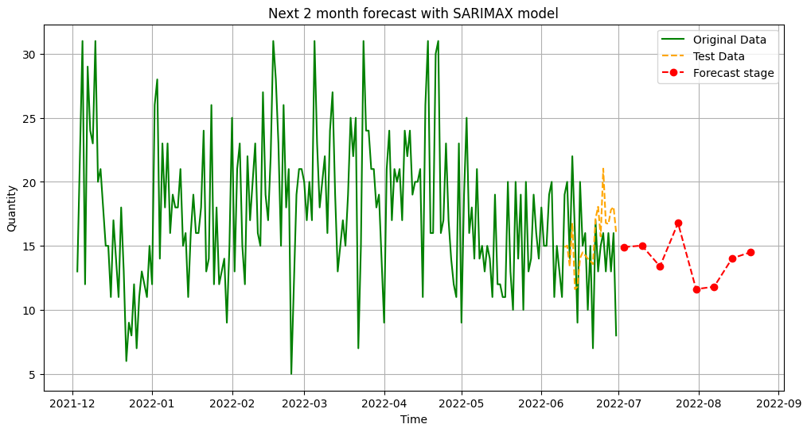
Next 2 months weekly predictions using best model (SARIMAX) :

Slide 21
Conclusion
The Future Cart: AI-Driven Demand Prediction for Smarter Retail project successfully developed a robust demand forecasting model by integrating historical sales data with Google Analytics and facebook impressions. Through advanced machine learning techniques, it enables retailers to optimize inventory, minimize waste, and make informed, data-driven decisions. This project highlights the transformative potential of AI in retail, paving the way for smarter operational strategies and improved customer satisfaction. Future work could expand the model by incorporating additional factors like economic trends or competitor data to enhance its predictive accuracy.

Slide 22
Thank you!

